Slide 1
City of Marion Tree Board
Educational Series - 2017
Tree Pests

Slide 2
Marion Tree Board
6 member advisory board appointed by the City Council
Current Tree Board Members are:
Chairperson John Reese, Joan Hensley, Nancy Clark, Phillip Tate, Dr. Beverly Watts and Ann Harkey
Assisted by City staff Debi Sherlin, Heather Cotton, Brant Sikes, City Arborist Lawrence Moore and others

Slide 3
Marion Tree Board
Works with City staff and Arborist to:
Develop Master Tree Plan for City
Make reports and recommendations to City Council
Facilitate planting, growth and protection of trees in City
Coordinate annual Arbor Day celebrations
Maintain City’s status as Tree City USA

Slide 4
What Tree Board Does
Education
Consultation
Advice
Coordination
Seeking funding
Oversight of trees on City property or rights of way

Slide 5
What Tree Board Does Not Do
Regulate trees on private property
Have an unlimited or large budget
Discourage growth, development and use of common sense
Discourage or prevent trees deemed hazardous from being removed

Slide 6
City Arborist
City contracts with Lawrence Moore for downtown landscaping and maintenance of trees
Mr. Moore is a certified Arborist
City staff consults with Mr. Moore and Tree Board, as needed, on matters involving health of trees on City property and rights of way or if residents have questions or concerns.

Slide 7
Tree City USA
The City of Marion recently was renewed as a Tree City USA for the 28th year.
There are 80 communities in North Carolina that are certified as a Tree City USA.
At 28 years, Marion has the 25th longest tenure as a Tree City USA among North Carolina cities.

Slide 8
Arbor Day
The Tree Board works with City staff to coordinate Arbor Day Celebrations at Marion Elementary School and Eastfield Global Magnet School.
Includes an educational program at each school and tree planting at locations selected by Tree Board.
Over 400 trees have been planted at Arbor Day Celebrations over past 20+ years.

Slide 9
Memorial and Honorary Tree Program
Tree Board has planted several trees in memory or honor of individuals who have served community, including long-time community cook Geneva Blanton, retired City Manager Earl Daniels and former Tree Board Members Pat Brown and Fay Rowe.
There are opportunities for individuals or organizations to purchase a tree in honor or memory of a loved one, with Tree Board review and approval.

Slide 10
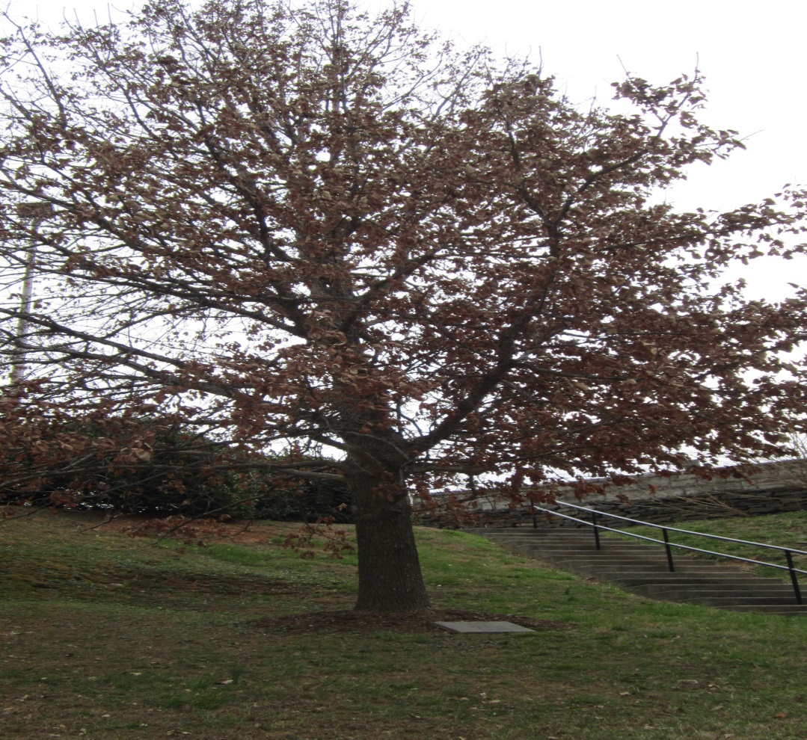
Geneva Blanton Memorial Tree – Community Building

Slide 11
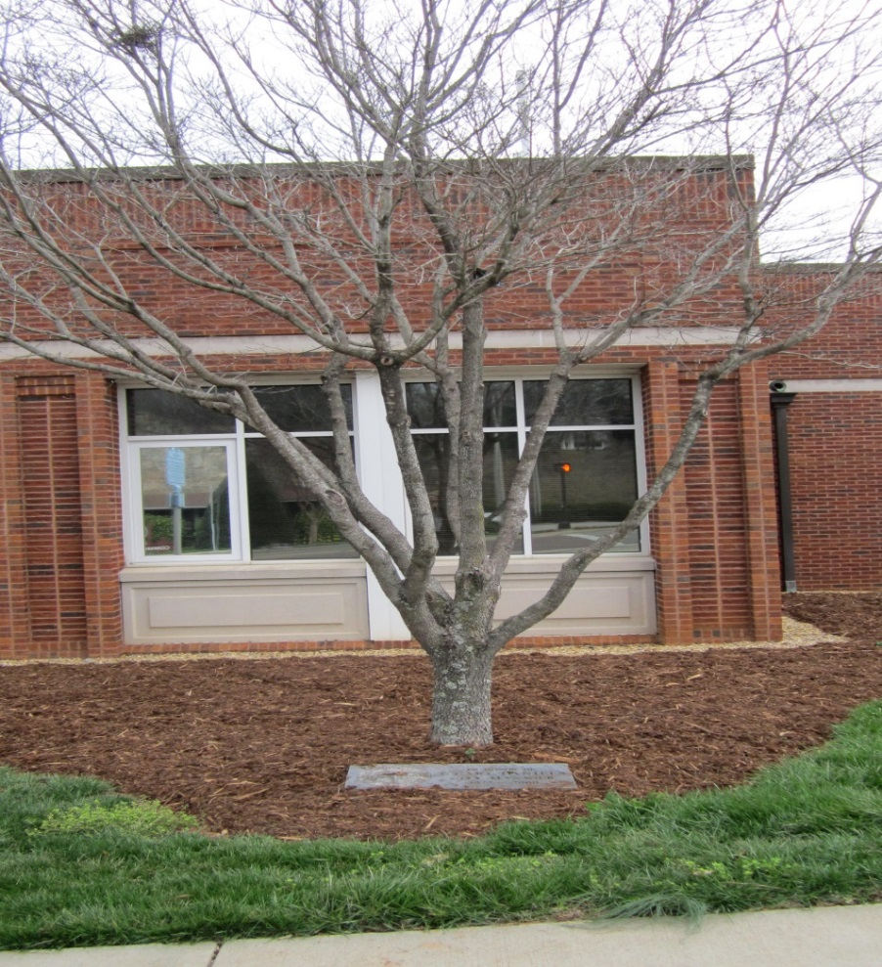
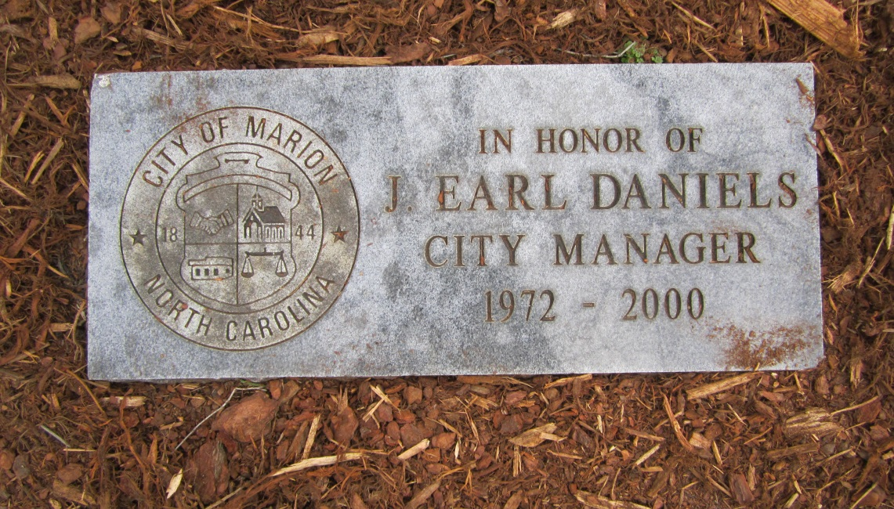
Earl Daniels Honorary Tree – City Hall

Slide 12
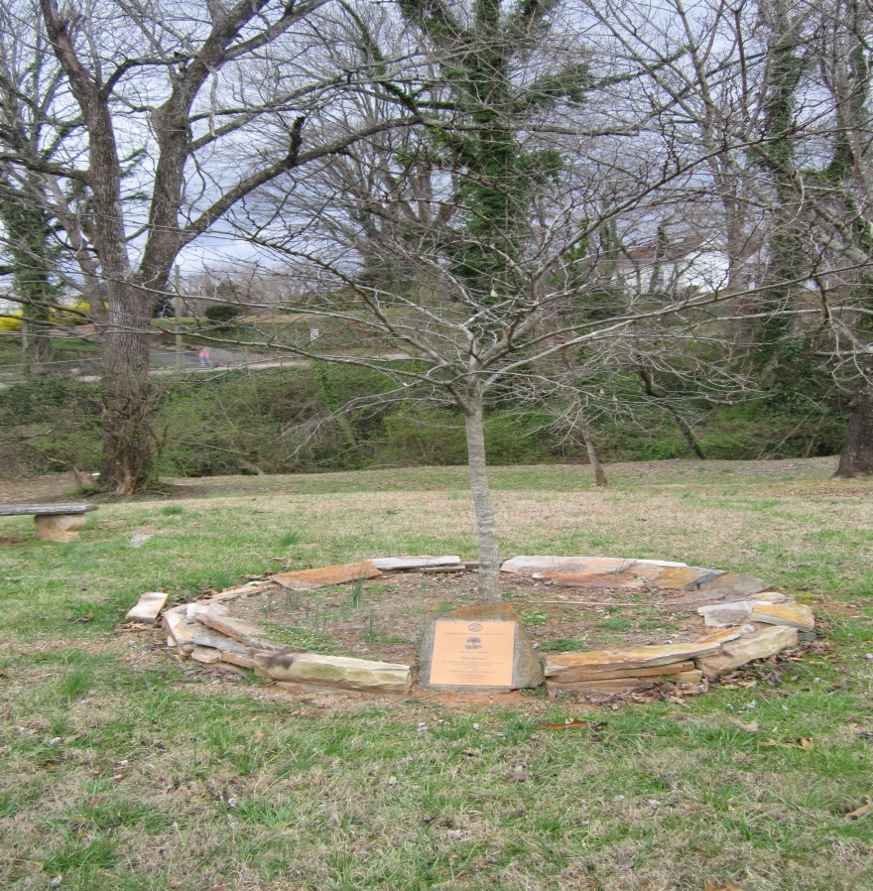
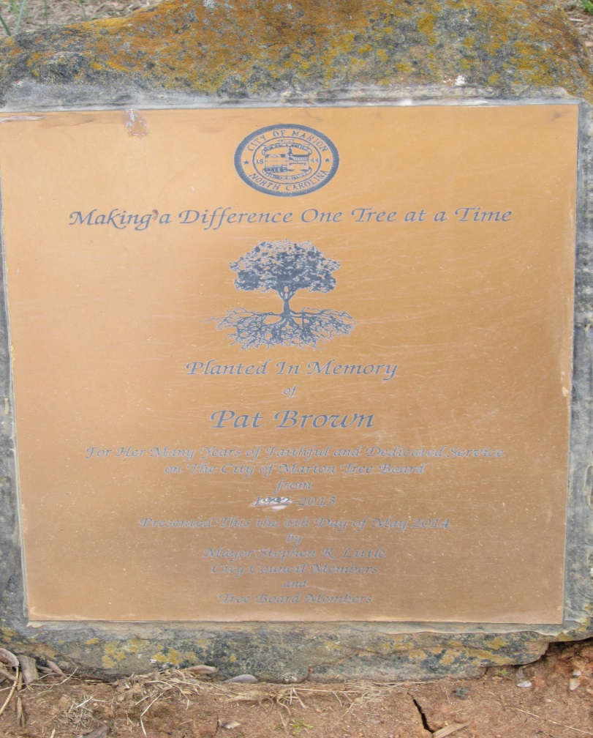
Pat Brown Memorial Tree – South Main Street Park

Slide 13
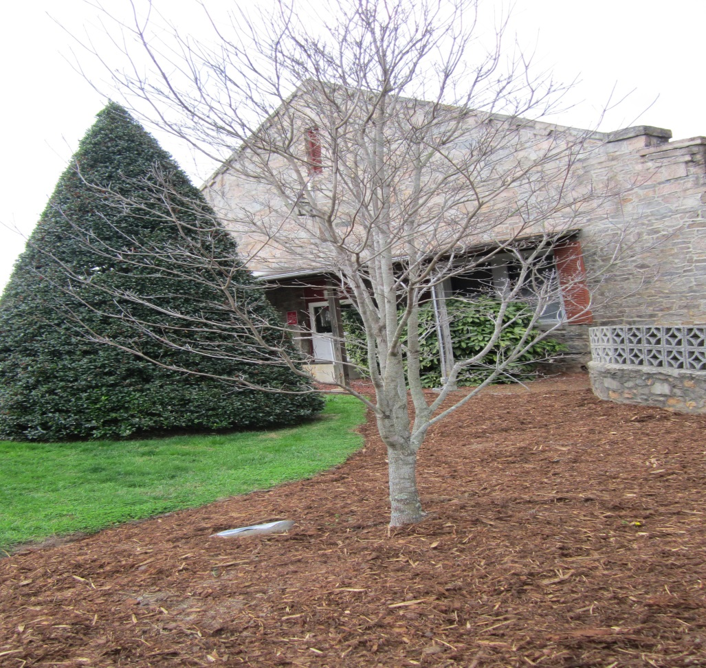
Fay Rowe Memorial Tree – Community Building

Slide 14
Educational Series
Focusing on topics of interest or importance, including for now:
Proper Tree Pruning
Tree Pests

Slide 15
Tree Insects and Diseases
Credit to Bob Neier, Kansas State Research & Extension

Slide 16
Tree Insects

Slide 17
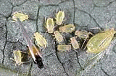
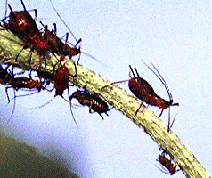
Aphids

Slide 18
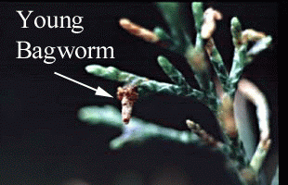
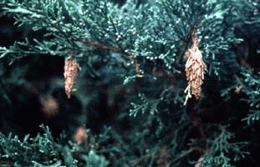
Bagworm

Slide 19
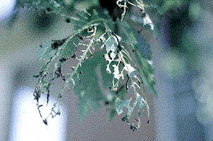
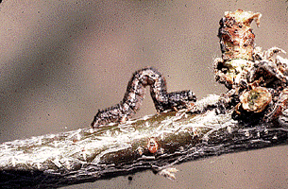
Cankerworm

Slide 20
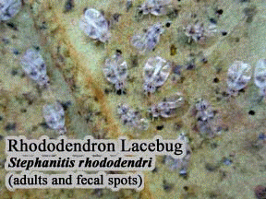
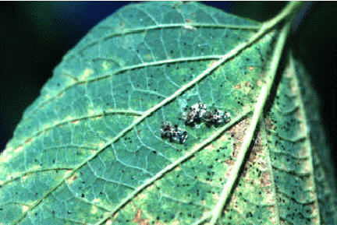
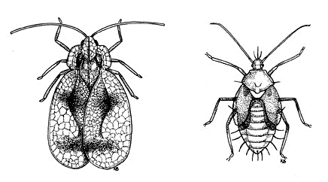
Lacebugs
Common on Sycamore and Pyracantha

Slide 21
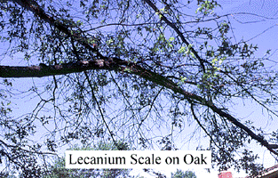
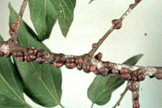
Scale Insects
Lecanium scale

Slide 22
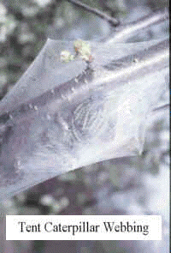
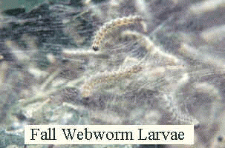
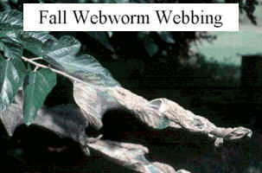
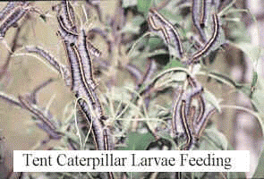
Webworm

Slide 23
Arborvitae
Mites
Fletcher Scale

Slide 24
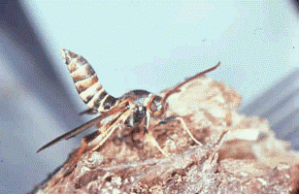
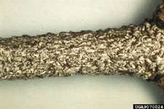
Ash
Ash lilac borer
Oystershell Scale
Mites

Slide 25

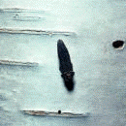
Bronze Birch Borer
European White Birch

Slide 26


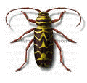


Black Locust/ Globe Locust
Locust Borer

Slide 27
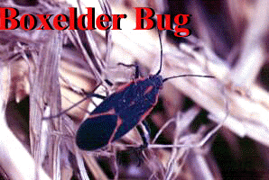
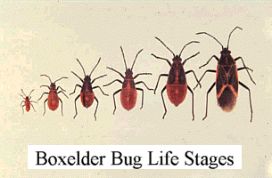
Boxelder/Goldenraintree
Boxelder Bug

Slide 28
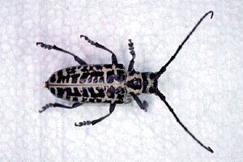

Cottonwood
Cottonwood Borer
Petiole Gall Aphid

Slide 29

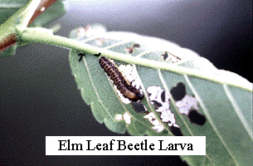
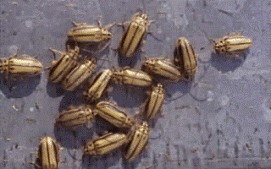
Elm
Aphids
Cankerworm
Elm Calligrapha
Elm Leaf Beetle
European Elm Scale
Lecanium Scale
Oystershell Scale
Scurfy Scale

Slide 30


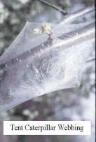
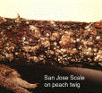

Flowering Fruit Trees
Aphids, Cankerworm, Eastern Tent Caterpillar, Fall Webworm, Flathead Borers, Peachtree Borer
Scale

Slide 31
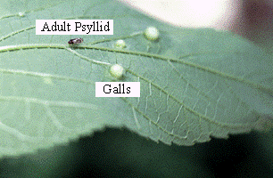
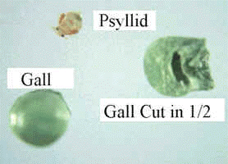
Hackberry
Hackberry Nibblegall Psyllid

Slide 32
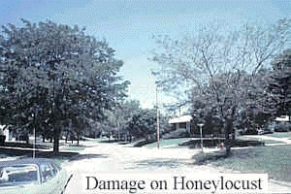
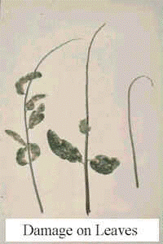
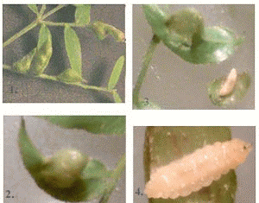
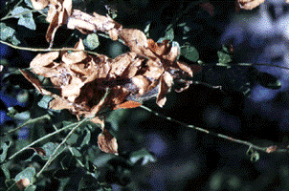
Honeylocust

Slide 33
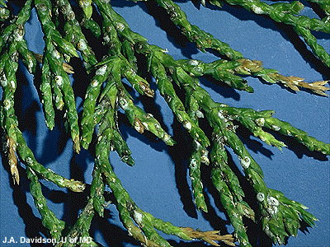
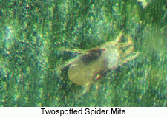

Juniper

Slide 34
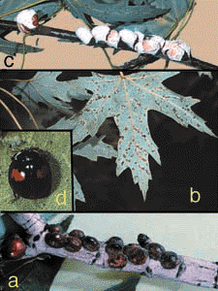
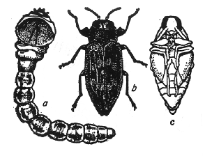
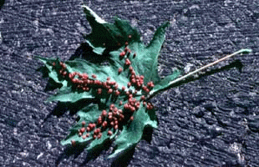
Maple
Flathead apple borer
Cottony maple scale
  Controlled by twice stabbed lady beetle
Maple Bladdergall mite

Slide 35
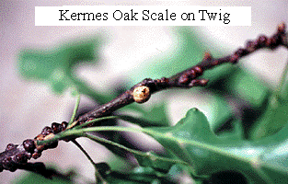

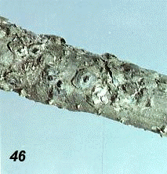
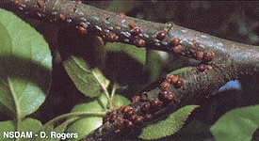
Oak
Caterpillars
Flathead wood borers
Kermes Scale (round balls)
Lecanium Scale
Obscure Scale
Lacebugs

Slide 36
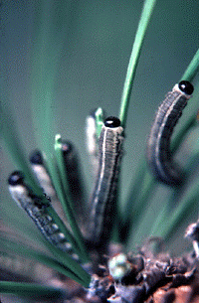
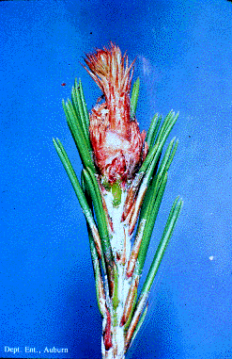
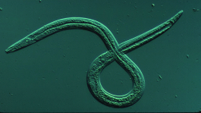
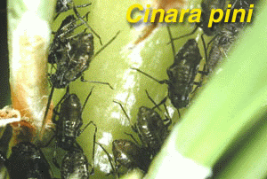


Pine
Aphid
Sawfly
Nantucket pine tip moth
Pine needle scale
Tortoise Scale
Pinewood Nematode

Slide 37




Redbud
Leafroller
Two striped spittlebug
Leafhopper

Slide 38

Spruce
Spruce needle miner
Bagworm
Mites

Slide 39


Sweetgum
Bagworm
Eastern Tent Caterpillar
Fall Webworm
Leaf Tier

Slide 40

Sycamore/London Planetree
Lacebug
Leafhopper

Slide 41

Walnut
Fall webworm
Walnut Caterpillar

Slide 42


Willow
Giant willow aphid

Slide 43
Tree Diseases

Slide 44





Scorch

Slide 45


Verticillium Wilt
Maple
Catalpa
Redbud
Smoketree

Slide 46




2,4-D Damage (dandelion spray)

Slide 47

Crown Gall
Cottonwood & poplar
Peach & plum

Slide 48






Canker

Slide 49





Rust
Cedar/apple/hawthorn
Ash

Slide 50


Arborvitae
Winter injury
Seridium canker

Slide 51



Ash
Anthracnose
Rust

Slide 52

Black Locust
Heart rot

Slide 53



Crabapple
Apple scab
Cedar Apple Rust
Powdery Mildew
Cankers

Slide 54


American Elm

Slide 55

Lacebark Elm
Leaf spot

Slide 56

Hackberry
Witches Broom

Slide 57

Hawthorn
Cedar/quince rust

Slide 58
Honeylocust
Thyronectria canker

Slide 59



Eastern Redcedar
Rust
Kabitina

Slide 60


Rocky Mountain (blue) Juniper
Botryosphaeria Canker

Slide 61



Maple
Scorch
Vertilillium wilt
Root rot

Slide 62


Mulberry
Leaf spot
Powdery mildew
Twig dieback

Slide 63




Oak
Anthracnose
Hypoxylon canker
Iron chlorosis
Sooty mold

Slide 64





Pine
Dothistroma
Sphaeropsis
Scorch
Natural Needle drop
Pine wilt

Slide 65




Willow
Cytospora canker
Leaf spots
Wetwood

Slide 66
Redbud
Verticillium wilt
Herbicide injury

Slide 67

Spruce
Rhizosphaera needlecast
Heat damage

Slide 68



Sycamore
Anthracnose
Mildew (London Planetree)

Slide 69
REFERENCES
U.S. FOREST SERVICE
TREE OWNERS MANUAL
www.na.fs.fed.us
INTERNATIONAL SOCIETY OF ARBORICULTURE
www.treesaregood.com

Slide 70
Questions

