Slide 1

City of Marion Tree Board
Educational Series - 2017
Tree Board Update/Importance of Proper Tree Pruning

Slide 2

Marion Tree Board
6 member advisory board appointed by the City Council
Current Tree Board Members are:
John Reese, Chairperson, Joan Hensley, Nancy Clark, Phillip Tate, Dr. Beverly Watts and Ann Harkey
Assisted by City staff Debi Sherlin, Heather Cotton, Brant Sikes, City Arborist Lawrence Moore and others

Slide 3

Marion Tree Board
Works with City staff and Arborist to:
Develop Master Tree Plan for City
Make reports and recommendations to City Council
Facilitate planting, growth and protection of trees in City
Coordinate annual Arbor Day celebrations
Maintain City’s status as Tree City USA

Slide 4

What Tree Board Does
Education
Consultation
Advice
Coordination
Seeking funding
Oversight of trees on City property or rights of way

Slide 5

What Tree Board Does Not Do
Regulate trees on private property
Have an unlimited or large budget
Discourage growth, development and use of common sense
Discourage or prevent trees deemed hazardous from being removed

Slide 6
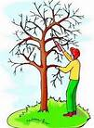
City Arborist
City contracts with Lawrence Moore for downtown landscaping and maintenance of trees
Mr. Moore is a certified Arborist
City staff consults with Mr. Moore and Tree Board, as needed, on matters involving health of trees on City property and rights of way or if residents have questions or concerns.

Slide 7

Tree City USA
The City of Marion recently was renewed as a Tree City USA for the 28th year.
There are 80 communities in North Carolina that are certified as a Tree City USA.
At 28 years, Marion has the 25th longest tenure as a Tree City USA among North Carolina cities.

Slide 8

Arbor Day
Tree Board works with City staff to coordinate Arbor Day Celebrations at Marion Elementary School and Eastfield Global Magnet School.
Includes an educational program at each school and tree planting at locations selected by Tree Board.
Over 400 trees have been planted on Arbor Days over past 20+ years.

Slide 9

Memorial and Honorary Tree Program
Tree Board has planted several trees in memory or honor of individuals who have served community, including long-time community cook Geneva Blanton, retired City Manager Earl Daniels and former Tree Board Members Pat Brown and Fay Rowe.
There are opportunities for individuals or organizations to purchase a tree in honor or memory of a loved one, with Tree Board review and approval.

Slide 10
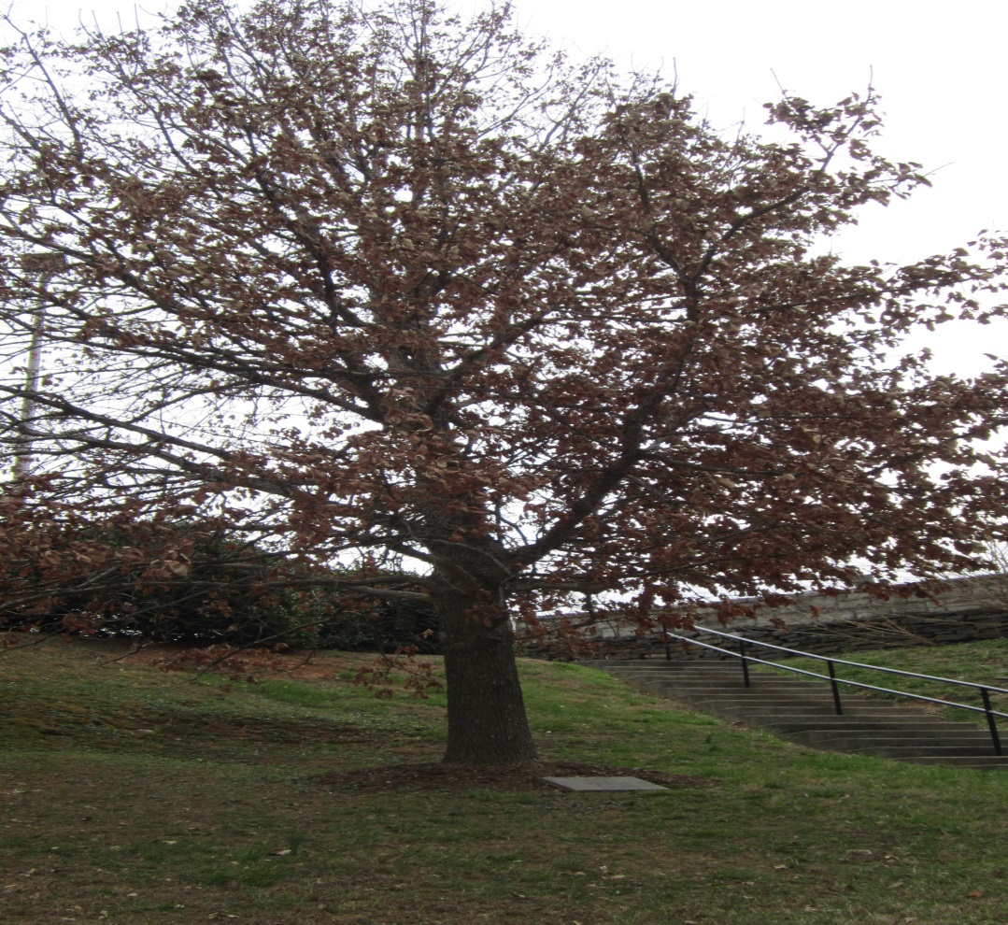
Geneva Blanton Memorial Tree – Community Building

Slide 11
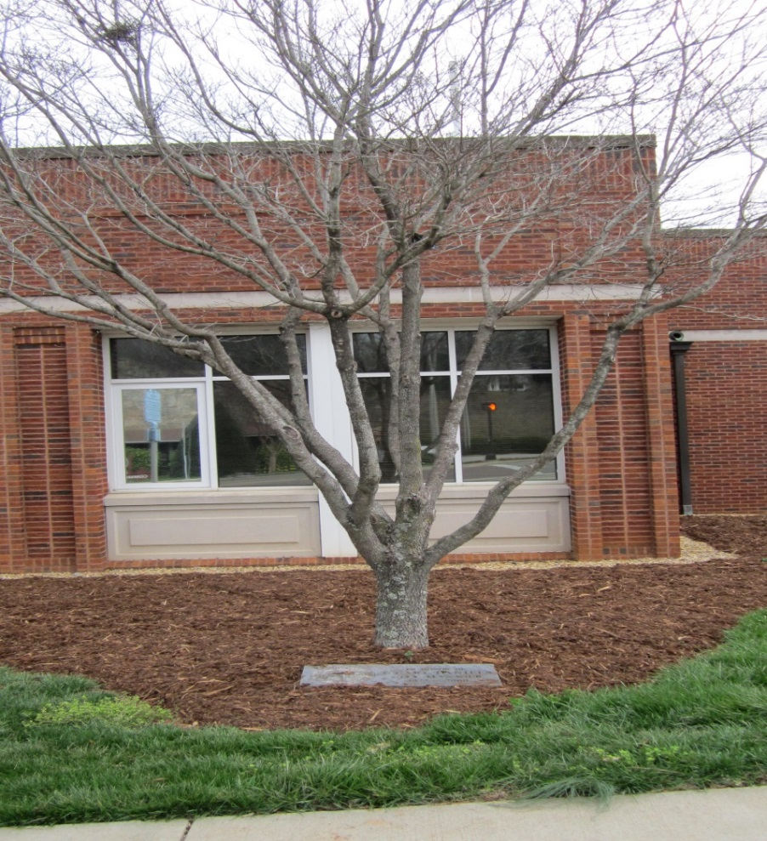
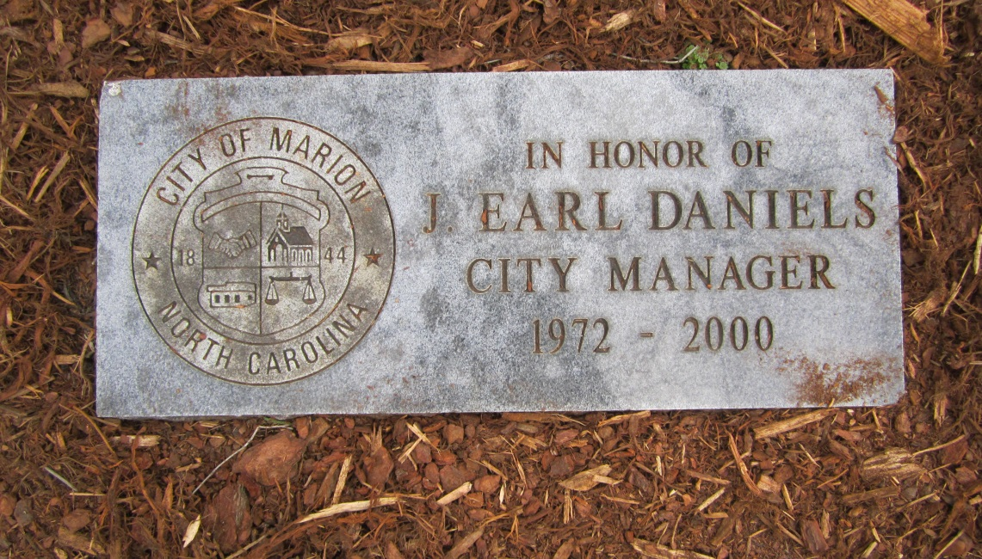
Earl Daniels Honorary Tree – City Hall

Slide 12
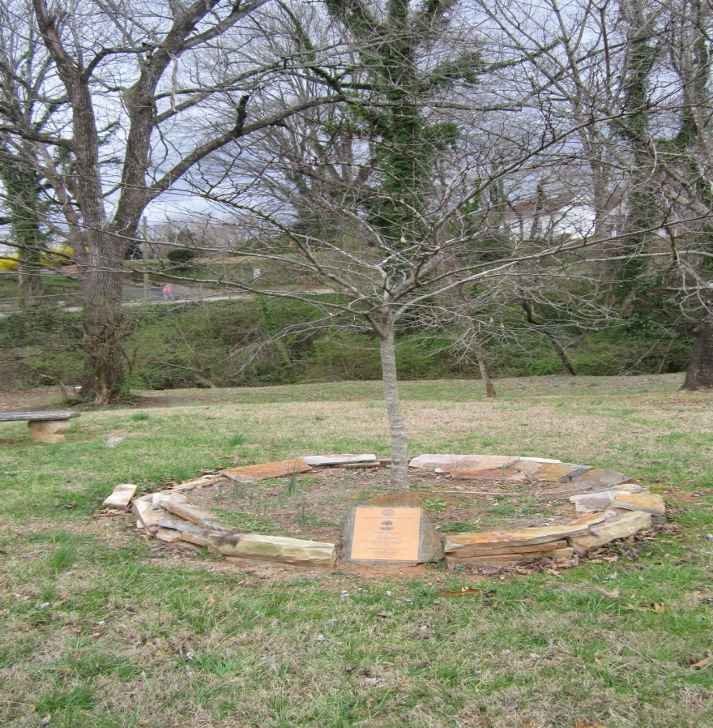
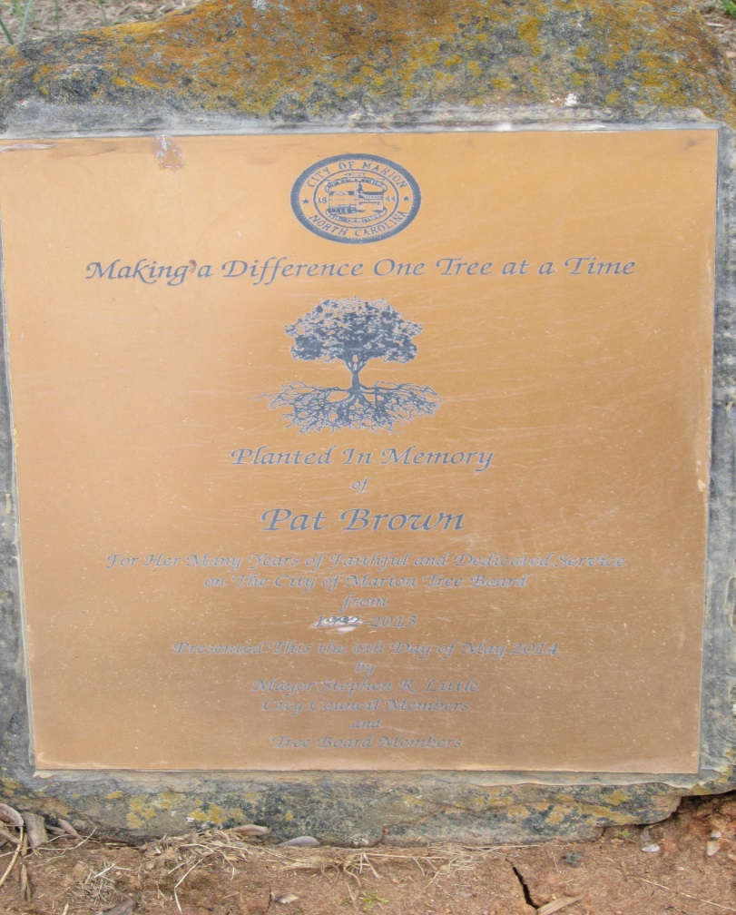
Pat Brown Memorial Tree – South Main Street Park

Slide 13
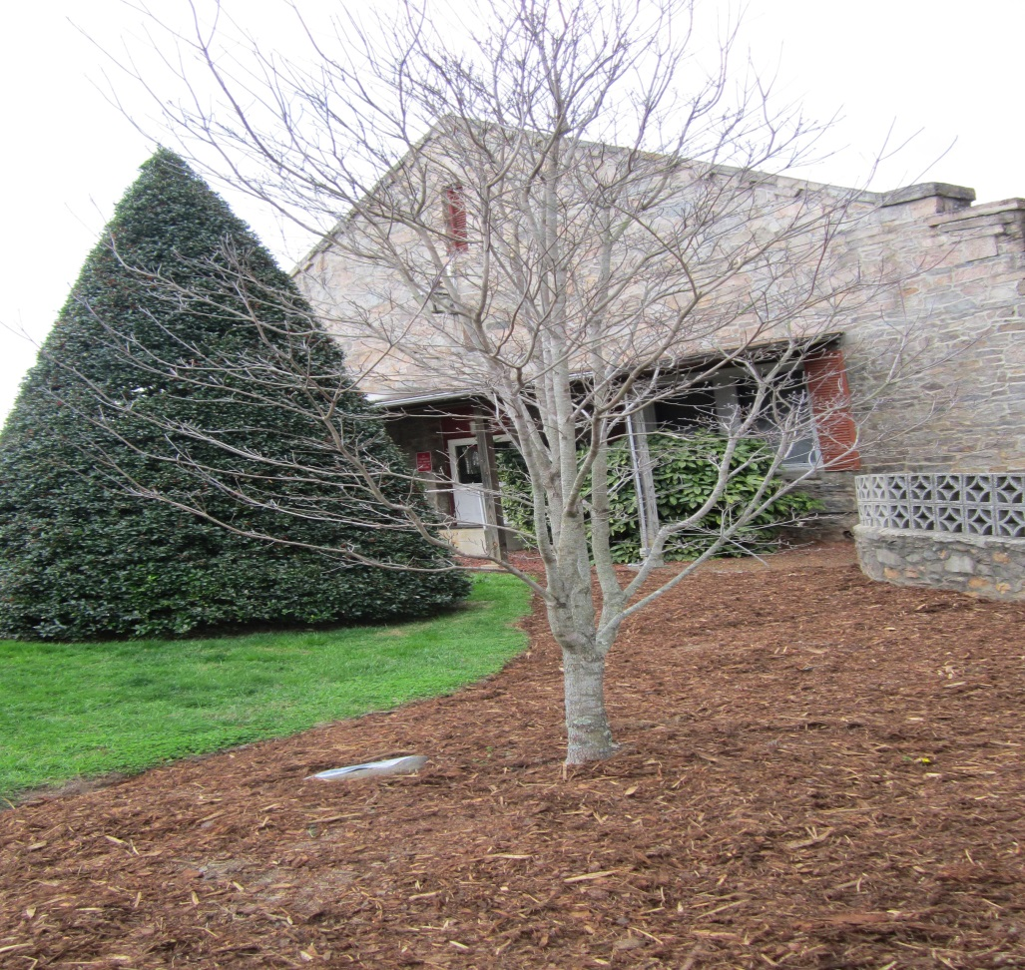
Fay Rowe Memorial Tree – Community Building

Slide 14

Educational Series
Focusing on topics of interest or importance, including for now:
Proper Tree Pruning
Tree Pests

Slide 15
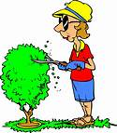
Importance of Proper Pruning

Slide 16
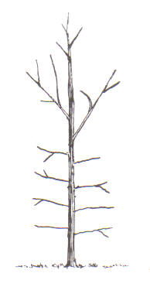
Pruned When Young At Planting
Pruned broken branches
Removed branch competing with the leader

Slide 17
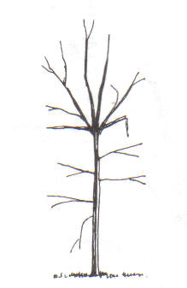
Not Pruned When Young At Planting
Did not prune broken branches or branches competing with the leader.

Slide 18
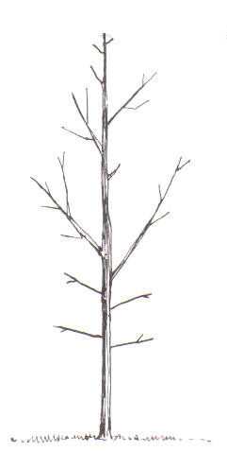
Pruned When Young
After 3-4 Years
Cut off suckers and sprouts in crown
Other excessive branches are thinned to reduce competition for light, water and nutrients
Co-dominant leader is removed
Notes:
Cut off suckers and sprouts in crown
Other excessive branches are thinned to reduce competition for light, water and nutrients
Co-dominant leader is removed

Slide 19
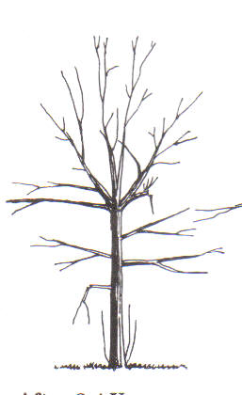
Not Pruned When Young
After 3-4 Years
Sprouts and suckers start to appear.
Root suckers zap strength from the tree.
Sprouts are disproportionally vigorous and weakly attached.
At broken limb, numerous branches have sprouted.
Notes:
Sprouts and suckers may appear
Root suckers zap strength from the tree
Sprouts are disproportionally vigorous and weakly attached
At broken limb, numerous branches have sprouted

Slide 20
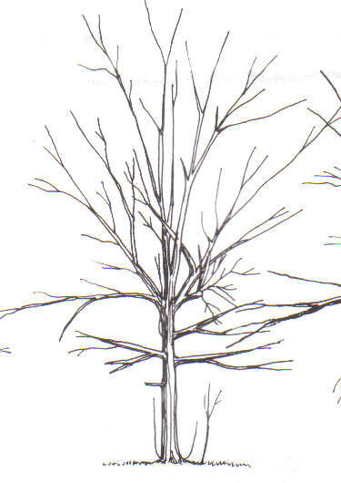
Not Pruned When Young
After 5-7 Years
Tree is becoming an adult.
Results of not making corrections early in life are now quite visible.
Notes:
Tree is becoming and adult
Results of not making corrections early in life are now quite visible

Slide 21
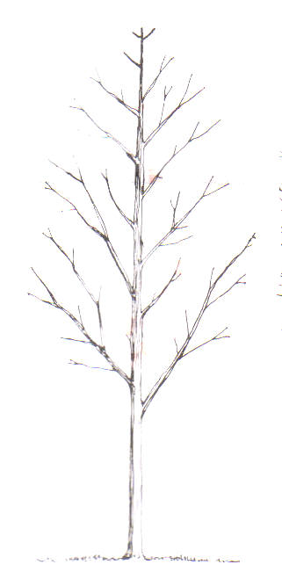
Pruned When Young
After 5-7 Years
Lower limbs are pruned off to “raise” the bottom of the crown well out of the way of human heads
Higher up, a few overzealous branches are cut back so not to protrude beyond the graceful outline of the crown
Notes:
Lower limbs are pruned off to “raise” the bottom of the crown well out of the way of human heads
Higher up, a few overzealous branches are cut back so they do not protrude beyond the graceful outline of the crown

Slide 22
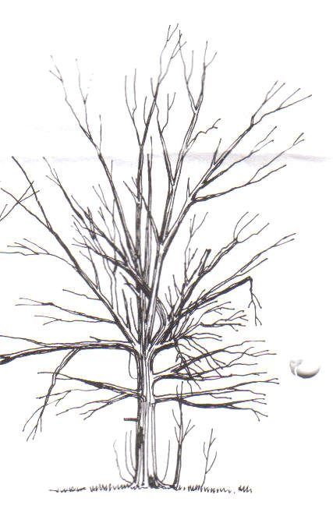
Not Pruned When Young
After 15 Years
Tree is not only unattractive, but dangerous when wind is blowing
Lopsided and dense, in full leaf, catches wind like a sail
Narrow branch angles and multiple leaders have resulted in a weak top
Tree is an accident waiting to happen
Notes:
Tree is not only unattractive , but dangerous,when wind is blowing
Lopsided and dense, in full leaf, catches wind like a sail
Narrow branch angles and multiple leaders have resulted in a weak top
Tree is an accident waiting to happen

Slide 23
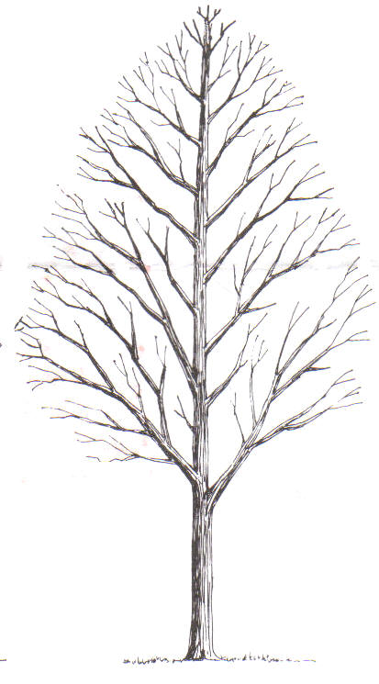
Pruned When Young
After 15 Years
Proper pruning has given strength to the branches and allows the wind to pass harmlessly trough the thinned crown.
Each spring, the tree gets scrutinized and dead or damaged limbs are cut off using proper pruning methods.
Notes:
Proper pruning has given strength to the branches and allows the wind to pass harmlessly trough the thinned crown.
Each spring, the tree gets scrutinized and dead or damaged limbs are cut off using proper pruning methods

Slide 24
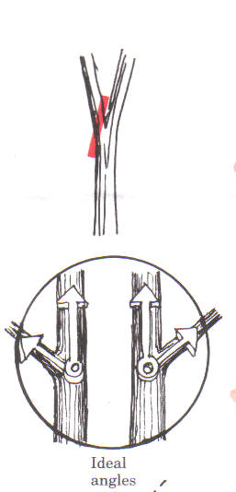
Pruning For Strength
Branch Angles
Narrow angles signal future weakness.
The reason is neither has sufficient space to add the wood needed for strength.
Remove one of the branches.
Ideal angle is 10 or 2 o’clock.
Notes:
Narrow angles signal future weakness.
The reason is neither has sufficient space to add the wood need for strength.
Remove one of the branches
Ideal angle is 10 or 2 o’clock

Slide 25
Pruning For Strength
Branch Size
Lateral branches should be no more than ½ to ¾ of the diameter of the trunk.
As the trunk grows, it will strengthen the joint by adding wood around the branch.
Notes:
Lateral branches should be no more than ½ to ¾ the diameter of the trunk.
As the trunk grows it will strengthen the joint by adding wood around the branch.

Slide 26
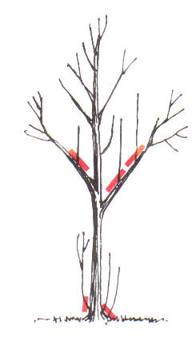
Pruning For Strength
Watersprouts and Suckers
These “parasite” sprouts can occur at the base or inside the crown.
They grow rapidly, are weakly attached and are upright.
They use more energy then they return to the tree.
Remove them as soon as possible.
Notes:
These “parasite” sprouts can occur at the base or inside the crown
They grow rapidly,are weakly attached and upright.
They use more energy then they return to the tree.
Remove them as soon as possible.

Slide 27
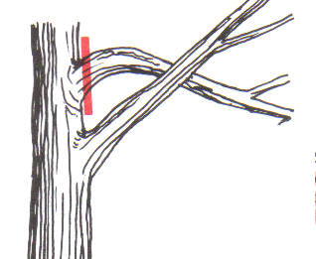
Pruning For Strength
Rubbing Branches
Branches that rub result in wounds, decay and notches.
Remove one of the offending branches.
Notes:
Branches that rub result in wounds, decay and notches.
Remove one of the offending branches.

Slide 28
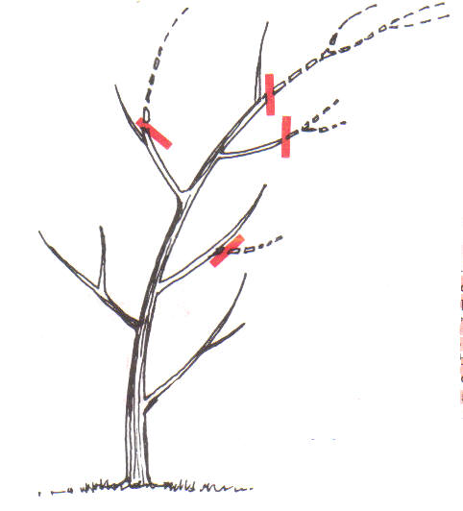
Pruning For Strength
Center of Gravity
Young trees deformed by wind may be corrected by pruning
Move the tree’s center of gravity to a point more central over the trunk by cutting back the leader and laterals on the downwind side.
Notes:
Young trees deformed by wind may be corrected by pruning
Move the tree’s center of gravity to a point more central over the trunk by cutting back the leader and laterals on the downwind side.

Slide 29
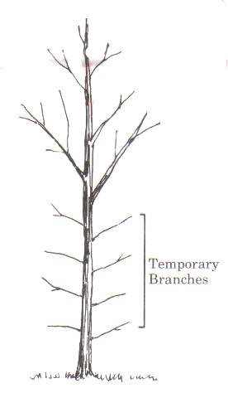
Pruning For Strength
Temporary Branches
Lower branches can protect young bark from injury from the sun and add taper and strength to the trunk.
May be left 3-4 years.
Remove over next 2-3 years.
Beginning with the larger temporary limbs.
Notes:
Lower branches can protect young bark from injury from the sun and add taper and strength to the trunk
May be left 3-4 years
Remove over next 2-3
Beginning with the larger temporary limbs

Slide 30
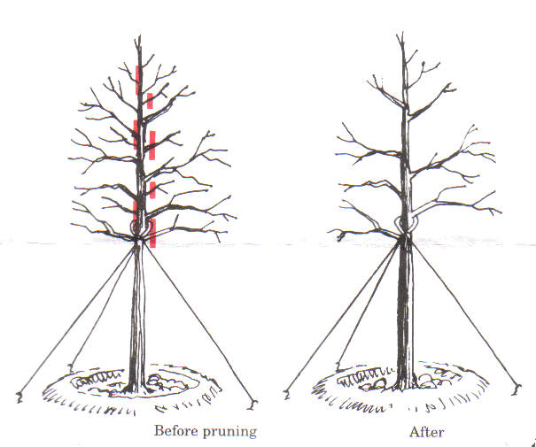
Pruning for Form
Thinning and Spacing
Most trees benefit from removing a portion of the limbs that compete for space and light.
Evenly spaced laterals, 8-12 inches apart in the young tree is a good rule of thumb to help assure the ideal “ladder” at maturity.
Notes:
Most trees benefit from removing a portion of the limbs that compete for space and light.
Evenly spaced laterals, 8-12 inches apart in the young tree is a good rule of thumb to help assure the ideal “ladder” at maturity.

Slide 31
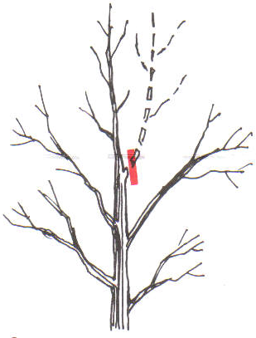
Pruning for Form
Double Leaders
Protect the leader from competition
With co-dominant leaders, remove the one with the crook or other defects, or that creates a lop-sided appearance.
Notes:
Protect the leader from competition
With co-dominant leaders, remove the one with the crook or other defects, or that creates a lop-sided appearance

Slide 32
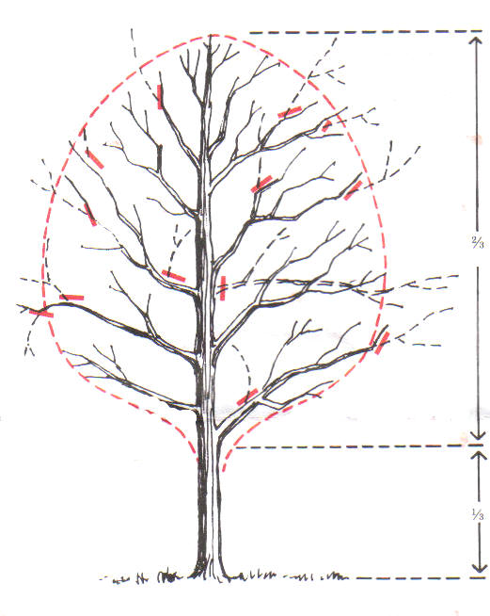
Pruning for Form
Ingrowers, Protruders and Crown Ratio
Remove limbs that turn inward and those that extend beyond “natural” outline of crown
Prune at trunk or at appropriate lateral branch
Over pruning can damage or kill tree.
Maintain 2/3 of the tree as crown
Notes:
Remove limbs that turn inward and those that extend beyond “natural” outline of crown
Prune at trunk or at appropriate lateral branch
Over pruning can damage or kill tree.
Maintain 2/3 of tree as crown

Slide 33

Keys To Good Pruning
Prune early in the life of the tree
Begin your visual inspection at the top of the tree
Remove defective parts before pruning for form
Identify the best leader and lateral branches
Don’t worry about protecting pruning cuts
Notes:
Prune early in the life of the tree
Begin your visual inspection at the top of the tree
Remove defective parts before pruning for form
Identify the best leader and lateral branches
Don’t worry about protecting pruning cuts

Slide 34
Keys To Good Pruning (Cont.)
Keep your tools sharp
Make safety a number one priority
When you prune back to the trunk or a larger limb, branches too small to have formed a collar should be cut close.
When simply shortening a small branch, make the cut at a lateral bud or another lateral branch. Cut should be sharp and clean, and made at a slight angle about ¼ inch beyond bud.
Notes:
Keep your tools sharp
Make safety a number one priority
When you prune back to the trunk or a larger limb, branches too small to have formed a collar should be cut close.
When simply shortening a small branch, make the cut at a lateral bud or another lateral branch. Cut should be sharp and clean, and made at a slight angle about ¼ inch beyond bud.

Slide 35

How to Hire an Arborist
Beware of door-knockers
Check the phone book
Is arborist certified
Ask for insurance
Ask for local references
Never let yourself be rushed
Get more than one estimate
Good arborist will offer wide range of services
Will not recommend topping
Will not use spikes (except when removing tree)
Removal of a living tree should be last resort
Notes:
Beware of door-knockers
Check the phone book
Is Arborist certified
Ask for insurance
Ask for local references
Never let yourself be rushed
Get more than one estimate
Good arborist will offer wide range of services
Will only rarely recommend topping
Will not use spikes (except when removing tree)
Removal of a living tree should be last resort.

Slide 36
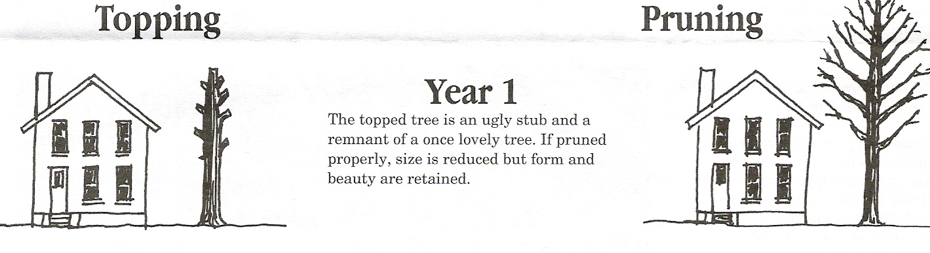
Year 1
Topping vs Pruning
The topped tree is an ugly stub and a remnant of a once stately tree. If pruned properly, size is reduced but form and beauty are retained.

Slide 37
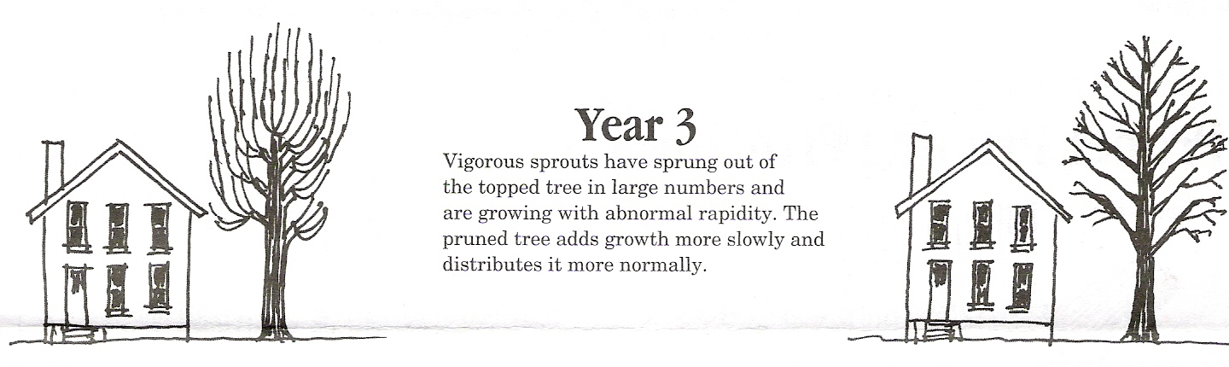
Year 3
Topping vs Pruning
Vigorous sprouts have sprung out of the topped tree in large numbers and are growing quickly making the tree weak and prone to pests and disease. The pruned tree adds growth more slowly and distributes it more normally making it a stronger tree.

Slide 38
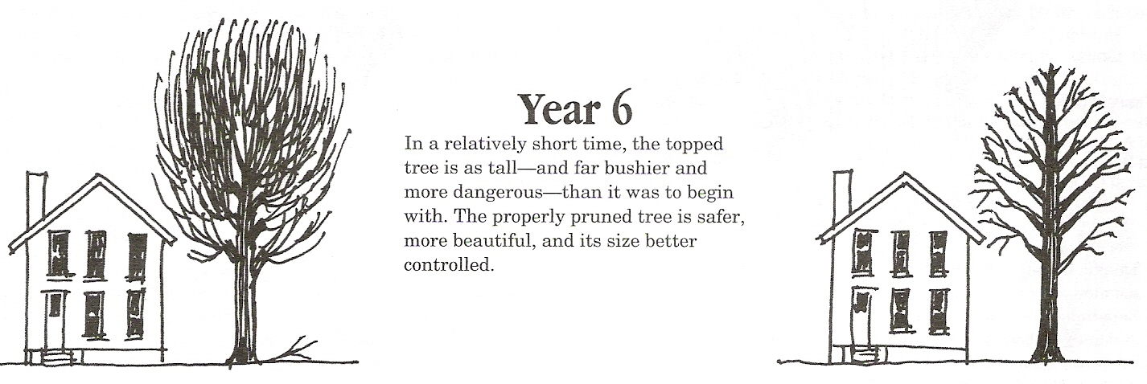
Year 6
Topping vs Pruning
In a relatively short time, the topped tree is as tall and far bushier and more dangerous than it was to begin with. The properly pruned tree is safer, more beautiful, and its size better controlled.

Slide 39

Why not to “Top”
Starvation: Good pruning practices rarely remove more than ¼ to ½ of the crown.
Shock: A tree’s crown is like an umbrella that shields much of the tree from the direct rays of the sun.
Insects and disease: The large stubs of a topped tree have a difficult time forming callus.
Weak limbs: At best, the wood of a new limb that sprouts after a larger limb is truncated is more weakly attached than a limb that develops more normally.

Slide 40

Why not to “Top”
Rapid New Growth: A goal of topping is usually to control the height and spread of a tree. Actually, is has just the opposite effect.
Tree Death: Some species of trees are less tolerant to topping than others.
Ugliness: A topped tree is a disfigured tree.
Cost: To a worker with a saw, topping is much easier that applying the skill and judgment needed for good pruning.

Slide 42
REFERENCES
U.S. FOREST SERVICE
TREE OWNERS MANUAL
www.na.fs.fed.us
INTERNATIONAL SOCIETY OF ARBORICULTURE
www.treesaregood.com

Slide 43

Questions?

